Slide 1

VA-DoD Survivors Forum
January 12th, 2016
U.S. Department of Labor
Veterans’ Employment and Training Service
Terry Gerton,
Deputy Assistant Secretary
Preparing Veterans and their families for Better Jobs

Slide 2

DOL VETS’ Vision and Mission
Vision: We will be the nationally recognized leader in helping veterans, service members and spouses find good jobs​.
Mission: We prepare America's veterans, service members and their spouses, for meaningful careers, provide them with employment resources and expertise, protect their employment rights and promote their employment opportunities.
We are here to help!

Slide 3
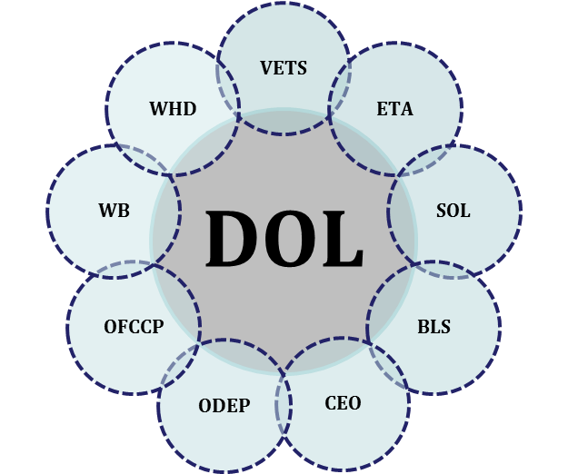
Integrated approach to serving veterans and their families
Veterans’ Employment and Training Service (VETS)
  Coordinates Agency efforts
Employment & Training Administration (ETA)
  National Workforce System (AJCs)
  UCX, Office of Apprenticeship, WIOA, Grants
Office of the Solicitor (SOL)
  Employment law expertise including enforcement in U.S. veteran discrimination cases.
Bureau of Labor Statistics (BLS)
  Continuously monitors and analyzes U.S. veteran employment statistics
Chief Evaluation Officer (CEO)
  Evaluates effectiveness /efficiency of Veteran employment programs
Office of Disability Employment Policy (ODEP)
  Focuses on disability-related policies that benefit veterans
Office of Federal Contract Compliance Programs (OFCCP)
  Affirmative action provisions of VEVRAA
Woman’s Bureau (WB)
  Develops policies, advocates for equality and economic security and promotes quality work environments for working women/veterans
Wage and Hour Division (WHD)
  Military Family Leave (FMLA)
Employee Benefits Security Administration (EBSA)
  Financial literacy/military retirement structure
DOL’s intense and extensive interoperability across all DOL agencies
Regional Locations:
Atlanta, Boston, Chicago, Dallas, Philadelphia, San Francisco

Slide 4
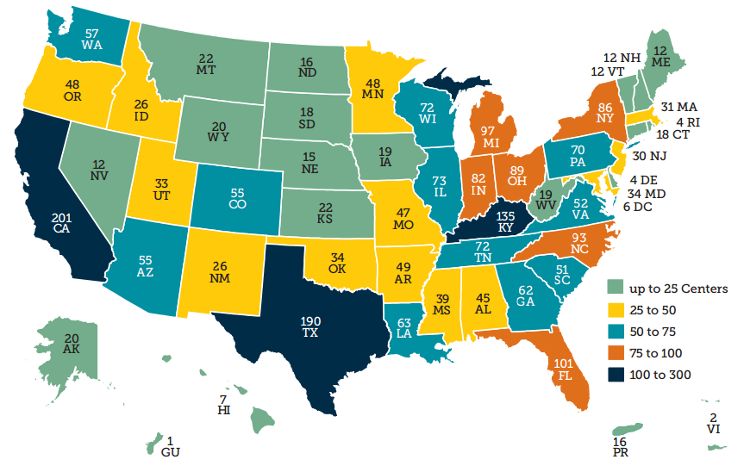
American Job Centers (AJCs) = 2,473
www.servicelocator.org
Notes:
The American Job Centers (AJC) are the centerpiece of veterans’ employment services in all the localities. These are funded
by the Department of Labor, administered by state-level Workforce Investment Boards (WIBs), and operated by local communities.
AJC provides comprehensive services to both employers and job seekers. It serves as the central location for HR Managers to meet and communicate with job seekers to match them to their current openings.
It is also the central point in the local community where customers (both veteran and nonveteran job seekers and employers) can access employment insurance, labor market information, employment/skill assessment services, and direct referrals to job training and job opportunities within their communities.

Slide 5
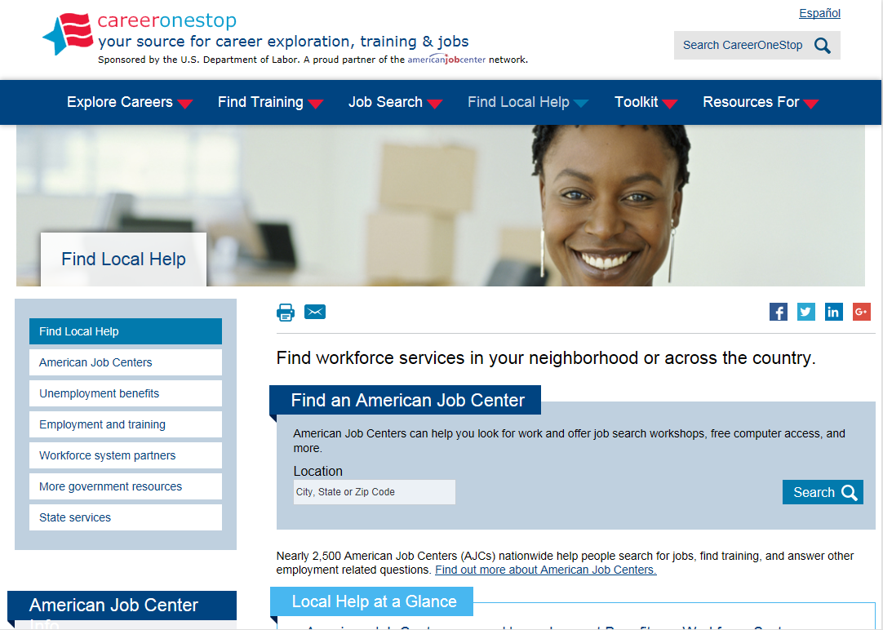
Service Locator.org

Slide 6

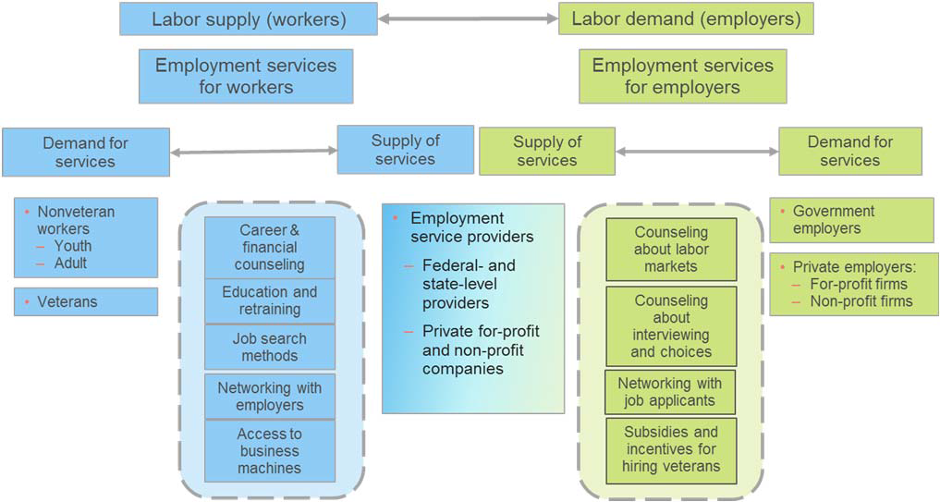
The AJC Concept
The AJC concept for connecting workers and employers in the job market
Priority of Service
Gold Card
Dislocated Worker
AJCs assisted over 13 million job seekers last year… nearly 1 million were veterans.

Slide 7
DOL services for survivors
Eligible to receive services from any of our 2,473 American Job Centers (AJCs)
Can access the virtual Transition Assistance Program through the DOL VETS website at www.dol.gov/vets
Eligible spouses and care-givers also receive priority of service in any DOL-funded program
Eligible spouses may also qualify for our Dislocated Worker Program, Displaced Homemaker, and other services at their local American Job Center
Eligible family members under the Family and Military Family Leave (FMLA) Act may take up to 26 workweeks of military caregiver leave to care for a service member with a serious injury or illness incurred or aggravated in the line of duty
Notes:
Q: What services does DOL provide to Surviving Spouses of Service Members killed in the line of duty or those who may have passed away from injuries sustained from the military?
All military spouses and spouses of veterans can receive services from any of our approximately 2,500 American Job Centers.
Eligible spouses, eligible surviving spouses, and eligible care-givers also receive priority of service in any DOL funded program, which means that they move to the front of the line for services.
Eligible surviving spouses include:
(A) The spouse of any person who died of a service-connected disability,
(B) The spouse of any member of the Armed Forces serving on active duty who, at the time of application for assistance under this chapter, is listed, pursuant to section 556 of title 37 and regulations issued thereunder, by the Secretary concerned in one or more of the following categories and has been so listed for a total of more than ninety days: (i) missing in action, (ii) captured in line of duty by a hostile force, or (iii) forcibly detained or interned in line of duty by a foreign government or power, or
(C) The spouse of any person who has a total disability permanent in nature resulting from a service-connected disability or the spouse of a veteran who died while a disability so evaluated was in existence.
These surviving spouses qualify for services from our JVSG program. Some of these spouses may also qualify for the Dislocated Worker Program.

Slide 8
Jobs for Veterans State Grant (JVSG)
Definition of Eligible Spouse
Eligible spouses include:
The spouse of any person who died of a service-connected disability
The spouse of any member of the Armed Forces serving on active duty who, at the time of application for assistance under this chapter, is listed, pursuant to section 556 of title 37 and regulations issued thereunder, by the Secretary concerned in one or more of the following categories and has been so listed for a total of more than ninety days: (i) missing in action, (ii) captured in line of duty by a hostile force, or (iii) forcibly detained or interned in line of duty by a foreign government or power
The spouse of any person who has a total disability permanent in nature resulting from a service-connected disability or the spouse of a veteran who died while a disability so evaluated was in existence
The spouse or family caregiver of a wounded, ill or injured service member and receiving treatment in military treatment facilities or warrior transition units

Slide 9
Dislocated Worker Eligibility
Workers who are unemployed and have lost a job through no fault of their own, including separating service members
Military spouses who lose employment as a direct result of relocation to accommodate a permanent change in duty station
Is a “displaced homemaker”
Services include Career and Training Services provided in the AJC, such as:
  Self Assessment
  Labor Market Information
  Job Search Assistance
  Individual Counseling
  Career Planning
  Written Employment Plan
  Training (Formal/Experiential)

Slide 10
Displaced Homemaker
Displaced Homemaker
A job seeker who has been providing unpaid services to family members in the home, and
Is unemployed or underemployed and is experiencing difficulty in obtaining or upgrading employment; and
Has been dependent on the income of another family member but is no longer supported by that income; or
Whose income is significantly reduced because of a deployment, order to active duty, permanent change of station, or service-connected death or disability of the member

Slide 11
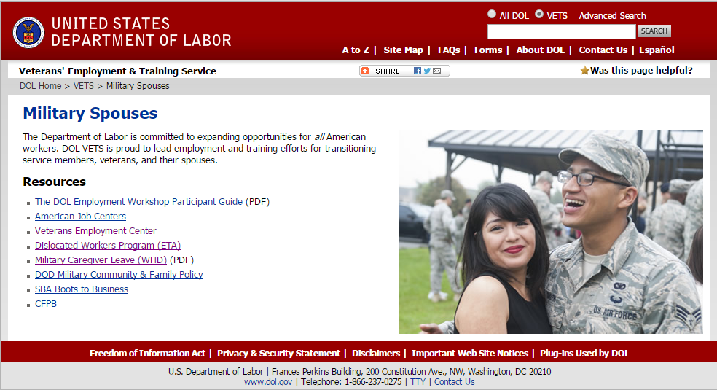
DOL VETS Spouses Web Page
http://www.dol.gov/vets/militaryspouses/

Slide 12
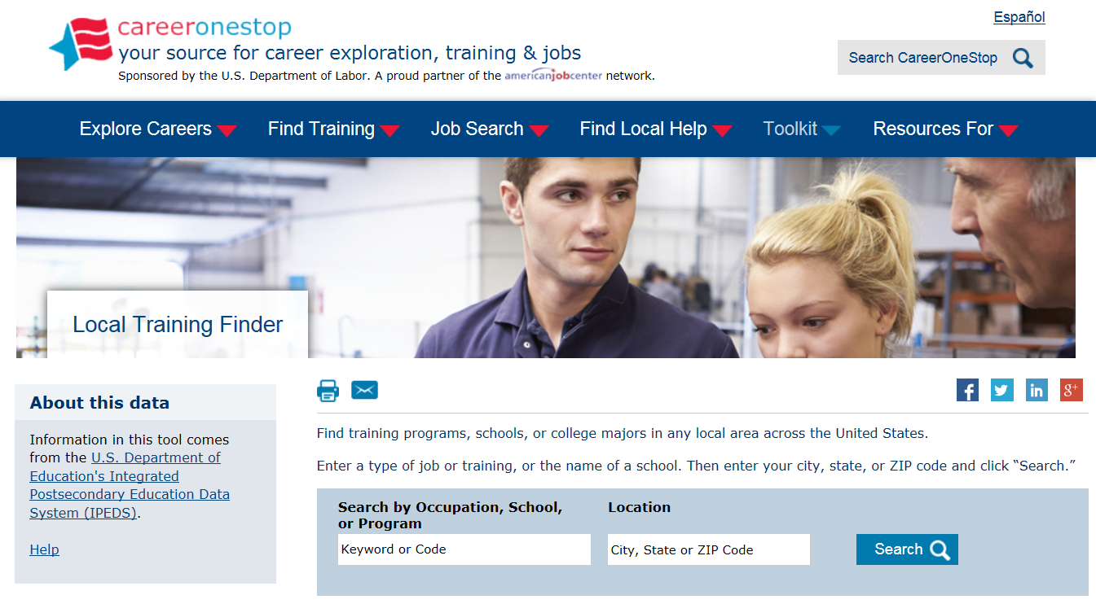
Short-Term Training Opportunities
http://www.careeronestop.org/toolkit/training/find-local-training.aspx

Slide 13
Short-Term Training Opportunities
Usually includes programs that last for two years or less and can include:
  Certificate programs
    Is an academic program
    Usually requires a high school degree
    Provides specialized training
    Many community and technical colleges offer short-term training
  Certifications
    May take a test to prove you have certain skills
    May be used to enter an occupation or advance in the current one
    Some employers may require these as a condition of employment (nurses, financial planners, etc.)
    Offered by national organizations that specialize in particular fields or technologies

Slide 14
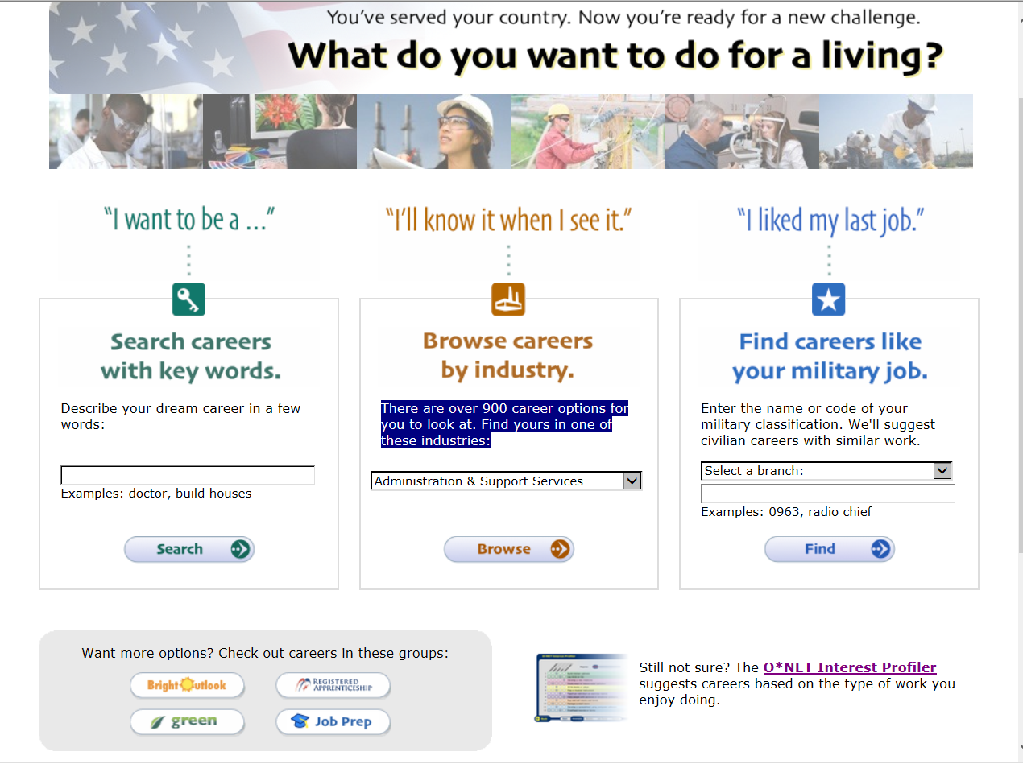
Explore your Career Options http://www.mynextmove.org/vets/
Notes:
14

Slide 15
Key Points
DOL offers incredible, free resources to help veterans and their families secure meaningful employment
Leaders in the community need to know about these resources and recommend them to the veterans, their families and employers
DOL already funds training programs that you may be eligible for
DOL is focused on increasing utilization of DOL and AJC services by veterans and their families and increasing employer engagement, resulting in better overall employment outcomes
Notes:
15

Slide 16
Thank you!
Questions?
www.dol.gov/vets

